Slide 1
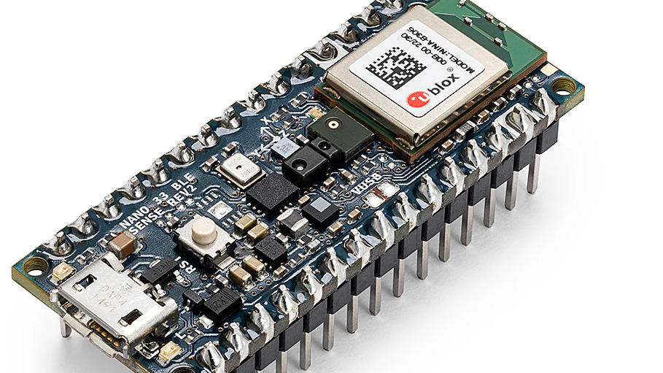
A Magnetometer-Driven Alert System for Asset Protection & Anti-Theft Systems
Submitted by –
Deepti Sahu 25071
Kaniki Bhikshapathi 24489
Puli Suhas Reddy 24123

Slide 2
Real-World Use-Cases
# | Use‑Case | What It Detects / When It Fires | Why the Magnetometer + TinyML Approach Matters
1 | Smart Door / Window Tamper Sensor | Lock‑picking, frame prying, or forced entry field spikes | Sees attacks that bypass simple reed‑switch “open/close” contacts
2 | Smart Locker / Safe Monitoring | Drilling, prying, or brute‑force motion near latch | Magnetic tool signature ≠ normal door swing → fewer false alarms
3 | Bike / Vehicle Tampering Alerts | Crow‑bar leverage, grinder motor near frame, or unauthorised movement | Ultra‑low‑power tag works indoors & underground where GPS fails
4 | Catalytic‑Converter Theft Deterrent | Reciprocating‑saw motor and rapid under‑car vibration | Alerts in seconds; signature is hard for thieves to spoof
5 | Container Seal Integrity | Bolt‑cutters, door slam, or magnet used to defeat reed switch | Timestamped BLE packet proves tamper during transit
6 | Museum / Display‑Case Asset Movement | Subtle artifact shift or panel removal | Completely silent & invisible—no privacy or aesthetic issues
7 | Industrial Equipment Protection | Sabotage on control panels, motors, or valves (wrench / drill) | Works in EMI‑heavy plants where vibration sensors chatter
8 | Tamper‑Proof Smart Meters / ATMs | External magnets, drilling, “black‑box” skimming devices | Flags fraud attempts before cash or data is accessed
9 | Indoor Asset Tracking (No GPS) | Movement of tagged tools, racks, or pallets via magnetic “fingerprint” | Reliable localisation in warehouses, basements, ships’ holds
10 | Pipeline Valve Tampering Alert | Wrench actuation or motorised opener at buried valve box | Early warning of sabotage or illegal tapping
11 | Solar‑Panel Theft Deterrent | Sudden unbolting / tilt of ferrous frames | Coin‑cell node + BLE mesh covers remote farms with no mains power
12 | Cargo Door Breach (Trucks / Vans) | Crow‑bar flex or forced unlock different from driver’s key | No line‑of‑sight required; data sent over BLE or mesh instantly
13 | Trailer Hitching Authorisation | Engagement of metallic tongue without permit | Differentiates legitimate hitch from illicit towing

Slide 3
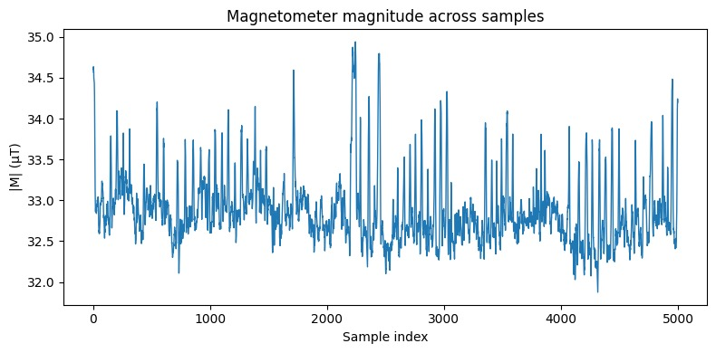
Data Collection and Visualization

Slide 4
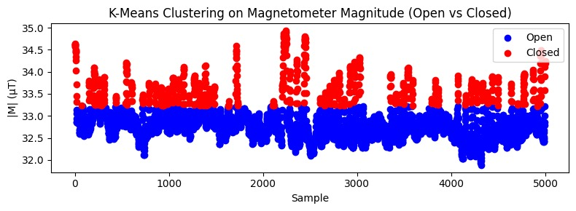
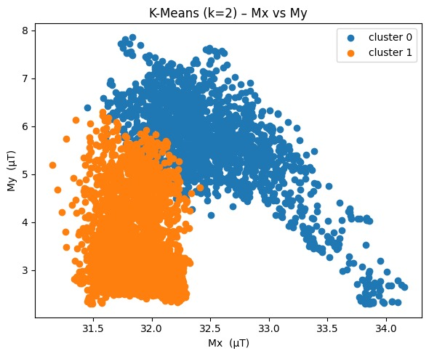
Data Labelling using K-mean Clustering

Slide 5
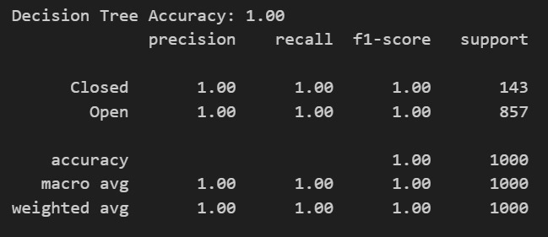
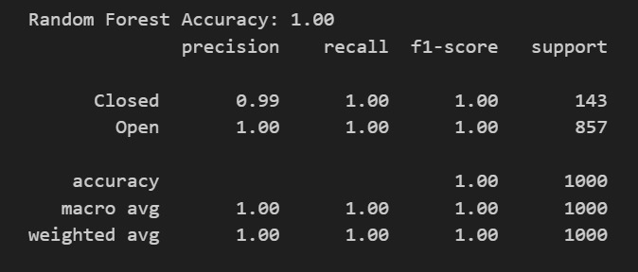
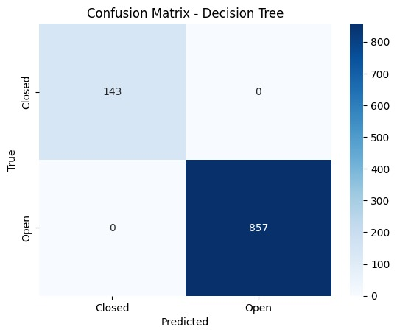

Model Training And Performance Analysis
Decision Tree
Random Forest

Slide 6
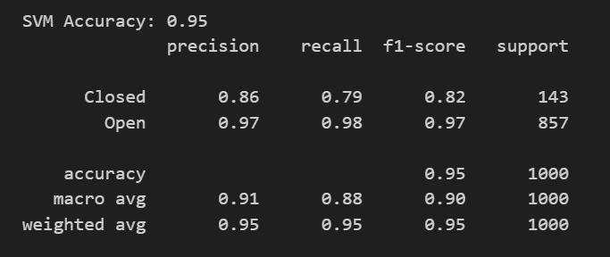
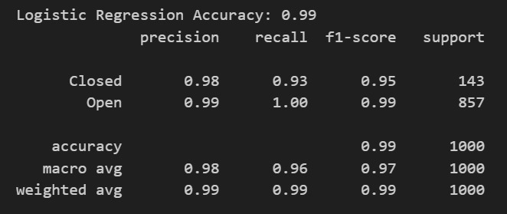


Support Vector Machine
Logistic Regression

Slide 7
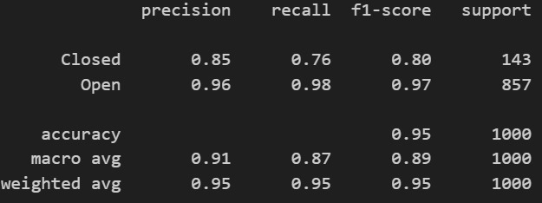
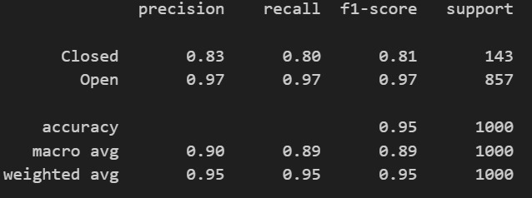

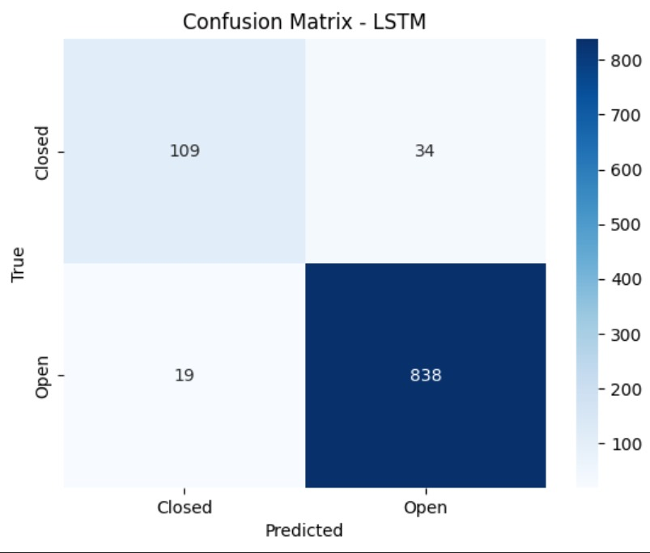
LSTM
1D CNN

Slide 8
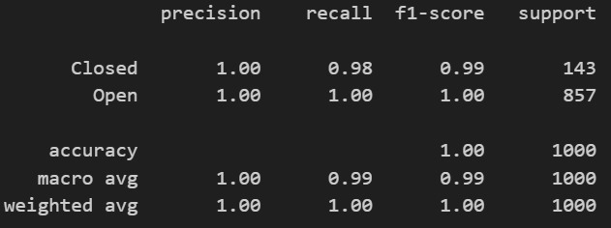

GRU – Gated Recurrent Unit

Slide 9
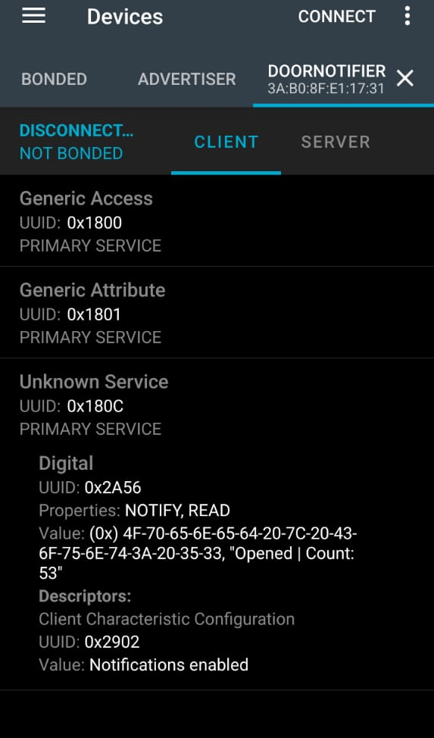
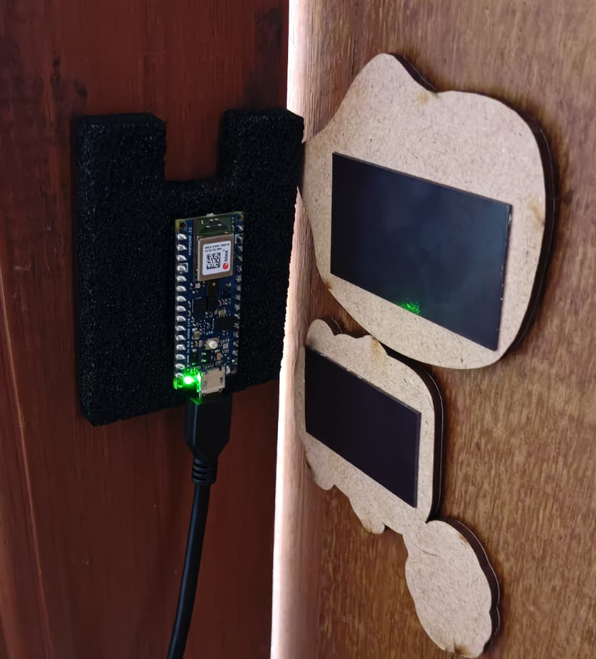
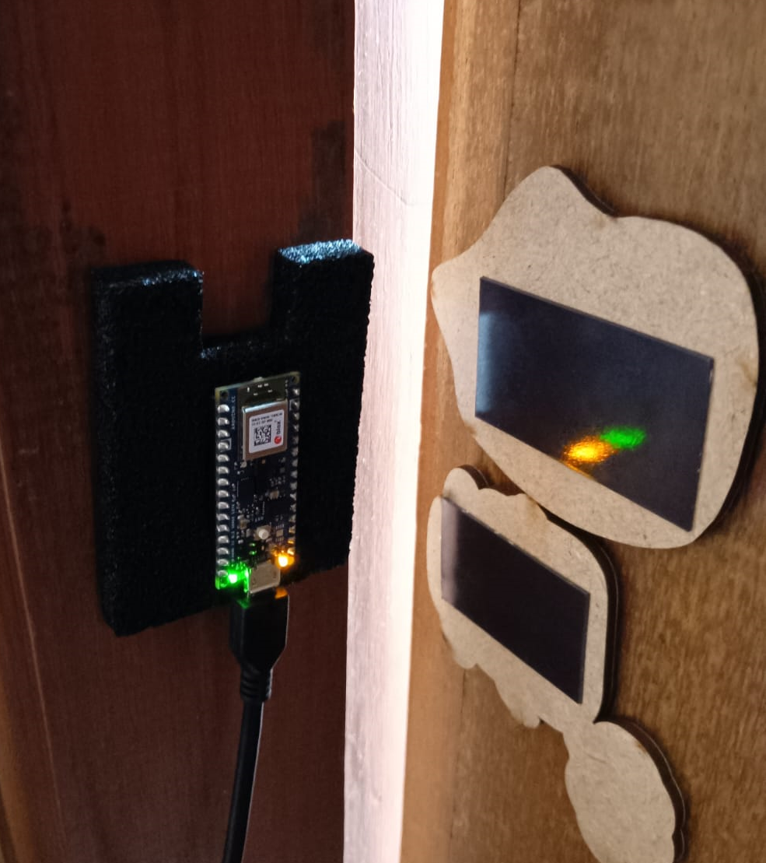
Model Deployment (Alert System)
Close (No blinking)
Open (blinks LED)
We are also tracking the number of counts of change (open to close or vice versa)
Bluetooth enabled system

Slide 10
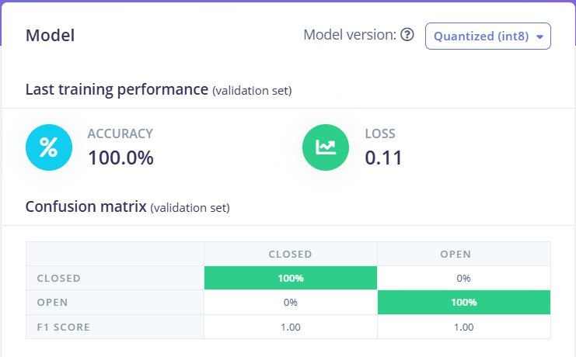
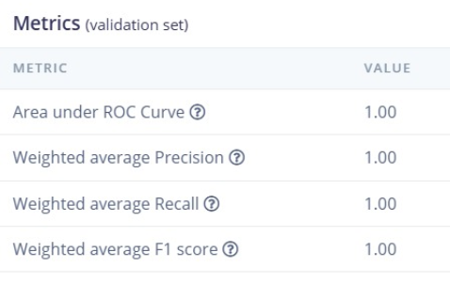
Deep Model Deployment (MLP) using Edge Impulse

Slide 11
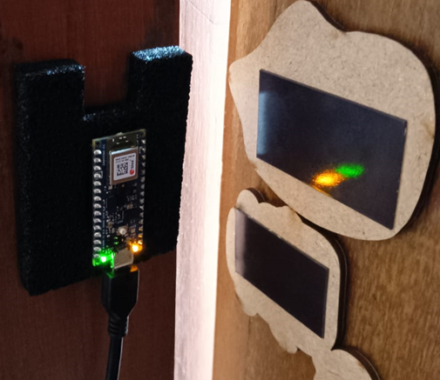
THANK YOU

